Slide 1
Applied Physics NS (101)
LECTURE # 6
DATE: 2ND SEPTEMBER , 2019

Slide 2
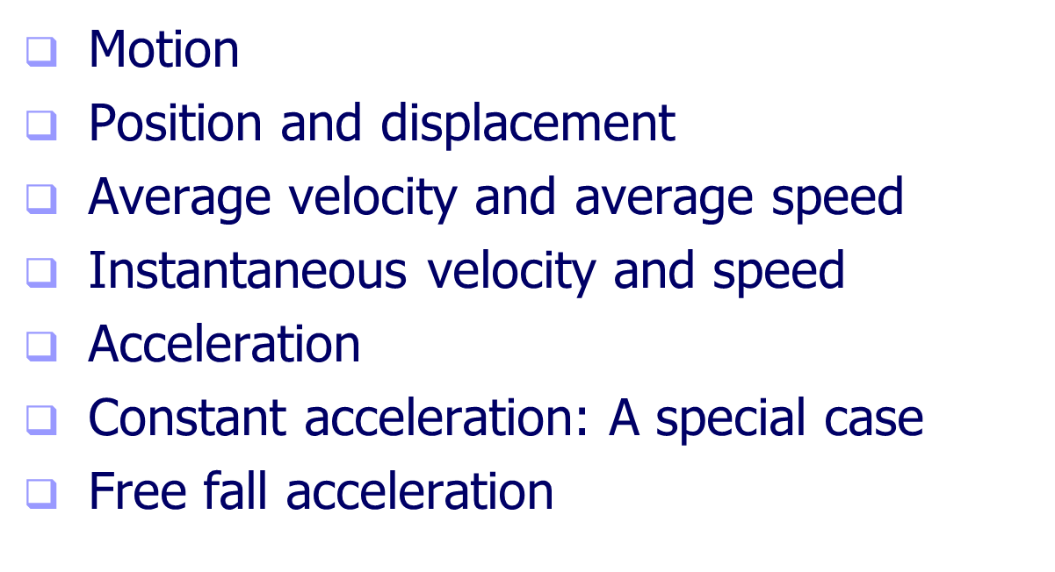
Linear Motion

Slide 3

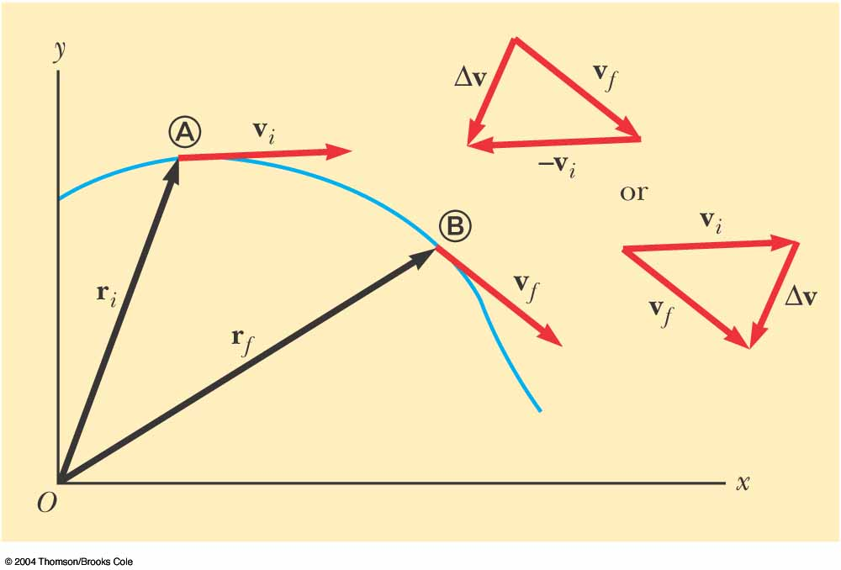


ACCELERATION
The average acceleration of the particle is defined as the change in velocity Δ vx divided by the time interval Δ t during which that change occurred:
The average acceleration is
a vector quantity directed
along ∆v .
Instantaneous Acceleration
The instantaneous acceleration equals the derivative of the velocity
with respect to time, which by definition is the slope of the velocity–time graph

Slide 4
Average Acceleration
Changing velocity (non-uniform) means an acceleration is present.
Acceleration is the rate of change of velocity.
Acceleration is a vector quantity.
Acceleration has both magnitude and direction.
Acceleration has a dimensions of length/time²: [m/s²].

Slide 5
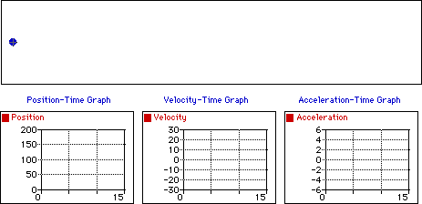
Constant velocity and acceleration
Observe that the object above moves with a constant velocity in the positive direction. The dot diagram shows that each consecutive dot is the same distance apart (i.e., a constant velocity). The position-time graph shows that the slope is both constant (meaning a constant velocity) and positive (meaning a positive velocity). The velocity-time graph shows a horizontal line with zero slope (meaning that there is zero acceleration); the line is located in the positive region of the graph (corresponding to a positive velocity). The acceleration-time graph shows a horizontal line at the zero mark (meaning zero acceleration).

Slide 6
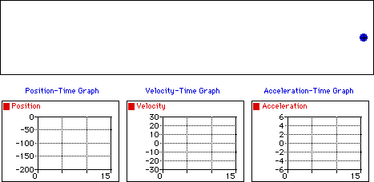
Constant negative velocity and acceleration
Observe that the object above moves with a constant velocity in the negative direction. The dot diagram shows that each consecutive dot is the same distance apart (i.e., a constant velocity). The position-time graph shows that the slope is both constant (meaning a constant velocity) and negative (meaning a negative velocity). The velocity-time graph shows a horizontal line with zero slope (meaning that there is zero acceleration); the line is located in the negative region of the graph (corresponding to a negative velocity). The acceleration-time graph shows a horizontal line at the zero mark (meaning zero acceleration).

Slide 7
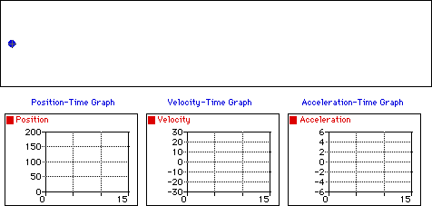
Position varies with positive velocity and acceleration
Observe that the object above moves in the positive direction with a changing velocity. An object which moves in the positive direction has a positive velocity. If the object is speeding up, then its acceleration vector is directed in the same direction as its motion (in this case, a positive acceleration). The dot diagram shows that each consecutive dot is not the same distance apart (i.e., a changing velocity). The position-time graph shows that the slope is changing (meaning a changing velocity) and positive (meaning a positive velocity). The velocity-time graph shows a line with a positive (upward) slope (meaning that there is a positive acceleration); the line is located in the positive region of the graph (corresponding to a positive velocity). The acceleration-time graph shows a horizontal line in the positive region of the graph (meaning a positive acceleration).

Slide 8
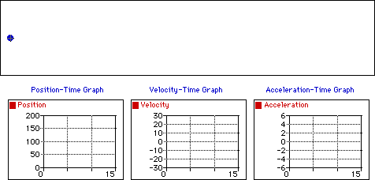
Position varies with positive velocity and negative acceleration
Observe that the object above moves in the positive direction with a changing velocity. An object which moves in the positive direction has a positive velocity. If the object is slowing down then its acceleration vector is directed in the opposite direction as its motion (in this case, a negative acceleration). The dot diagram shows that each consecutive dot is not the same distance apart (i.e., a changing velocity). The position-time graph shows that the slope is changing (meaning a changing velocity) and positive (meaning a positive velocity). The velocity-time graph shows a line with a negative (downward) slope (meaning that there is a negative acceleration); the line is located in the positive region of the graph (corresponding to a positive velocity). The acceleration-time graph shows a horizontal line in the negative region of the graph (meaning a negative acceleration).

Slide 9
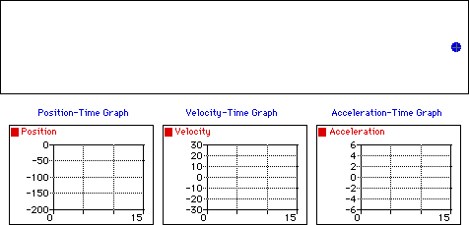
Decrease position with velocity and acceleration
Observe that the object above moves in the negative direction with a changing velocity. An object which moves in the negative direction has a negative velocity. If the object is speeding up then its acceleration vector is directed in the same direction as its motion (in this case, a negative acceleration). The dot diagram shows that each consecutive dot is not the same distance apart (i.e., a changing velocity). The position-time graph shows that the slope is changing (meaning a changing velocity) and negative (meaning a negative velocity). The velocity-time graph shows a line with a negative (downward) slope (meaning that there is a negative acceleration); the line is located in the negative region of the graph (corresponding to a negative velocity). The acceleration-time graph shows a horizontal line in the negative region of the graph (meaning a negative acceleration).

Slide 10
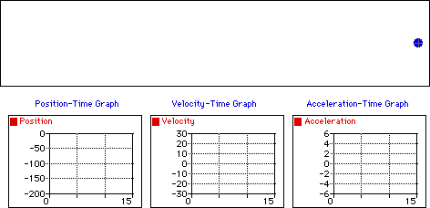
Decrease position with negative velocity and positive acceleration
Observe that the object above moves in the negative direction with a changing velocity. An object which moves in the negative direction has a negative velocity. If the object is slowing down then its acceleration vector is directed in the opposite direction as its motion (in this case, a positive acceleration). The dot diagram shows that each consecutive dot is not the same distance apart (i.e., a changing velocity). The position-time graph shows that the slope is changing (meaning a changing velocity) and negative (meaning a negative velocity). The velocity-time graph shows a line with a positive (upward) slope (meaning that there is a positive acceleration); the line is located in the negative region of the graph (corresponding to a negative velocity). The acceleration-time graph shows a horizontal line in the positive region of the graph (meaning a positive acceleration).

Slide 11
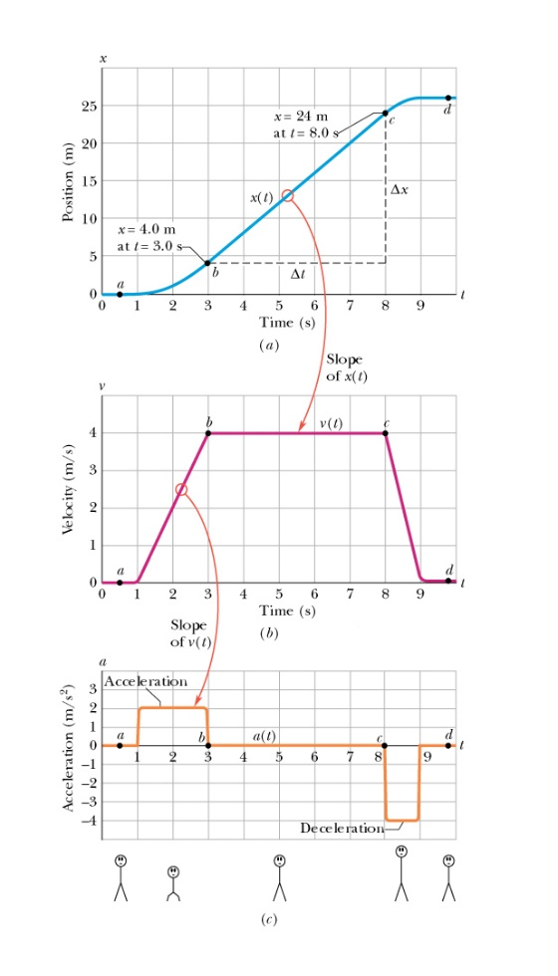
Example:
An elevator cab that is initially stationary , then moves upward, and then stops.

Slide 12
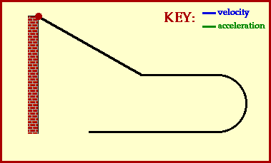
Direction of acceleration and velocity

Slide 13
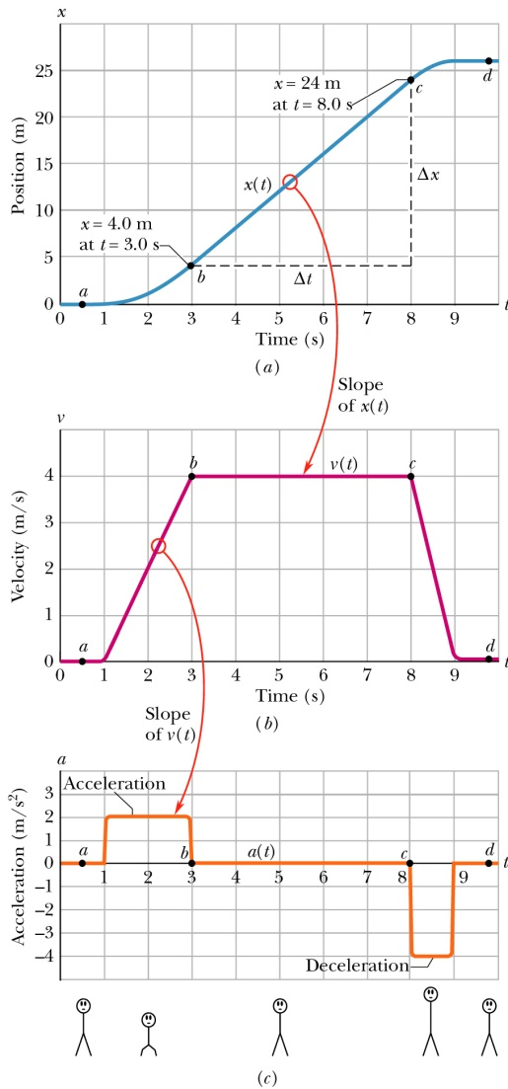

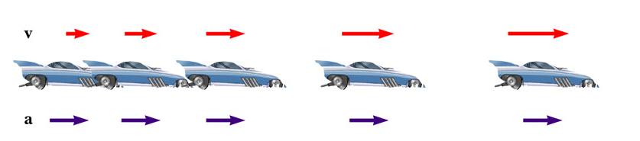
Relationship between Acceleration and Velocity (First Stage)
Velocity and acceleration are in the same direction
Acceleration is uniform (blue arrows maintain the same length)
Velocity is increasing (red arrows are getting longer)
Positive velocity and positive acceleration

Slide 14
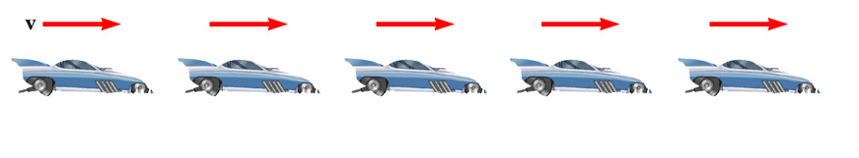
Relationship between Acceleration and Velocity (Second Stage)
Uniform velocity (shown by red arrows maintaining the same size)
Acceleration equals zero

Slide 15
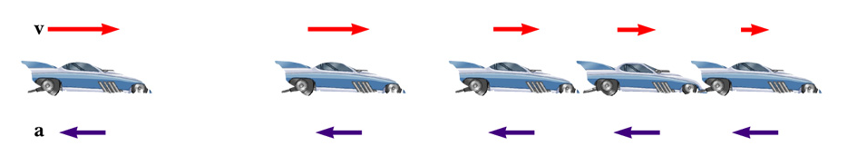
Relationship between Acceleration and Velocity (Third Stage)
Acceleration and velocity are in opposite directions
Acceleration is uniform (blue arrows maintain the same length)
Velocity is decreasing (red arrows are getting shorter)
Velocity is positive and acceleration is negative

Slide 16

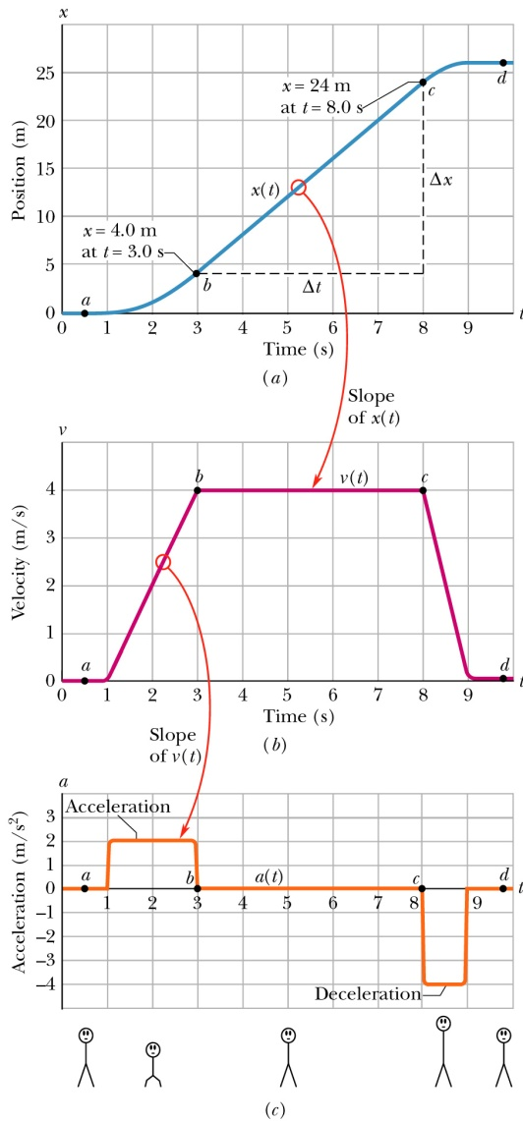
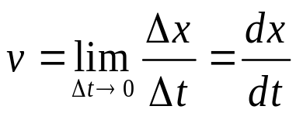
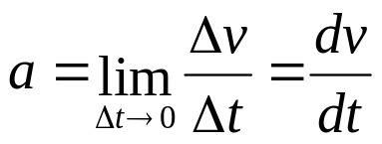
Kinematic Variables: x, v, a
Position is a function of time:
Velocity is the rate of change of position.
Acceleration is the rate of change of velocity.
Position Velocity Acceleration
Graphical relationship between x, v, and a
This same plot can apply to an elevator that is initially stationary, then moves upward, and then stops. Plot v and a as a function of time.

Slide 17
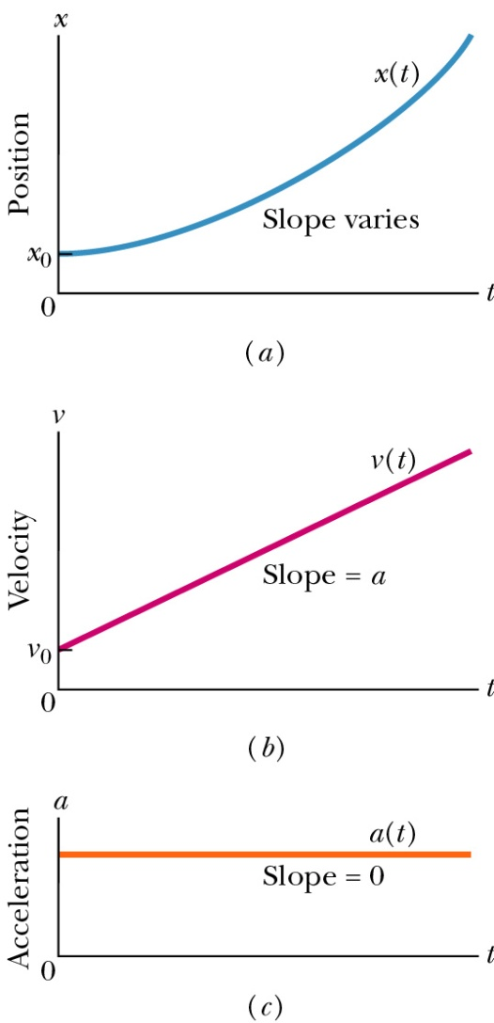
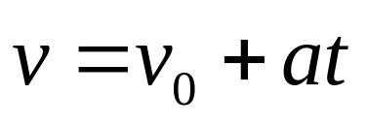
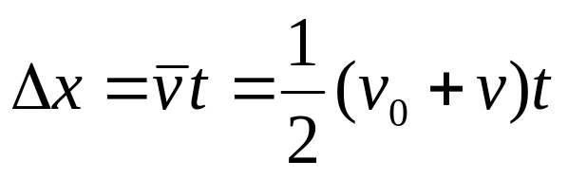
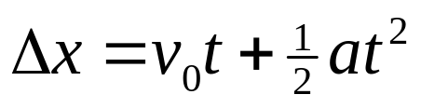
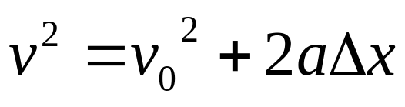
Special Case: Motion with Uniform Acceleration (our typical case)
Acceleration is a constant
Kinematic Equations (which we will derive in a moment)

Slide 18
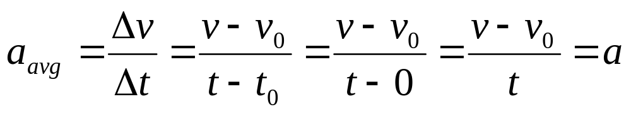
Derivation of the Equation (1)
Given initial conditions:
  a(t) = constant = a, v(t = 0) = v₀, x(t = 0) = x₀
Start with definition of average acceleration:
We immediately get the first equation
Shows velocity as a function of acceleration and time
Use when you don’t know and aren’t asked to find the displacement

Slide 19
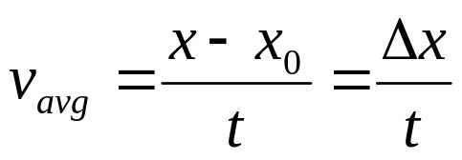
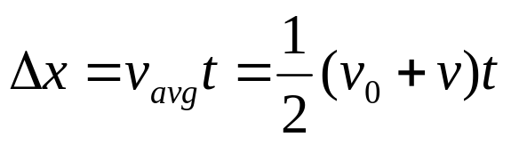
Derivation of the Equation (2)
Given initial conditions:
  a(t) = constant = a, v(t = 0) = v₀, x(t = 0) = x₀
Start with definition of average velocity:
Since velocity changes at a constant rate, we have
Gives displacement as a function of velocity and time
Use when you don’t know and aren’t asked for the acceleration

Slide 20

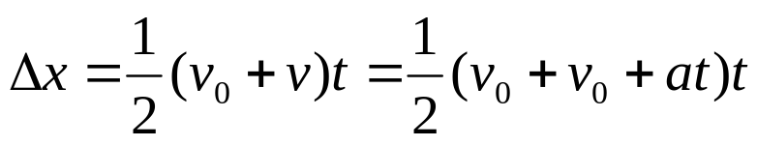
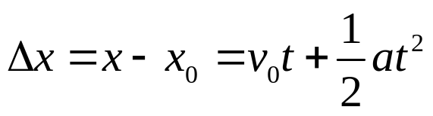
Derivation of the Equation (3)
Given initial conditions:
  a(t) = constant = a, v(t = 0) = v₀, x(t = 0) = x₀
Start with the two just-derived equations:
We have
Gives displacement as a function of all three quantities: time, initial velocity and acceleration
Use when you don’t know and aren’t asked to find the final velocity

Slide 21
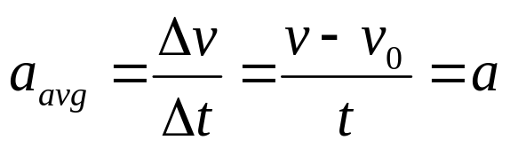
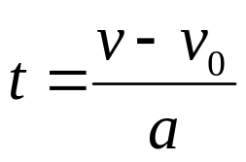
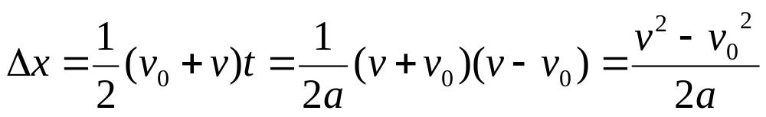
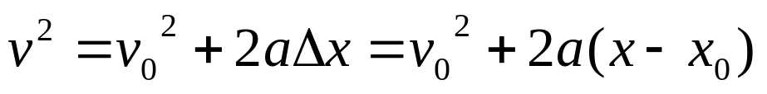
Derivation of the Equation (4)
Given initial conditions:
  a(t) = constant = a, v(t = 0) = v₀, x(t = 0) = x₀
Rearrange the definition of average acceleration
, to find the time
Use it to eliminate t in the second equation:
, rearrange to get
Gives velocity as a function of acceleration and displacement
Use when you don’t know and aren’t asked for the time

Slide 22
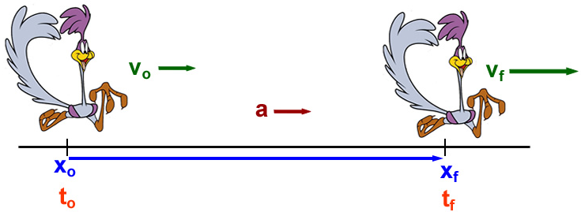



Problem-Solving Hints
Read the problem
Draw a diagram
  Choose a coordinate system, label initial and final points, indicate a positive direction for velocities and accelerations
Label all quantities, be sure all the units are consistent
  Convert if necessary
Choose the appropriate kinematic equation
Solve for the unknowns
  You may have to solve two equations for two unknowns
Check your results
Notes:
The best way to gain confidence in the use of these equations is to work a number of problems. The following procedure is recommended for solving problems involving acceleration motion.

Slide 23
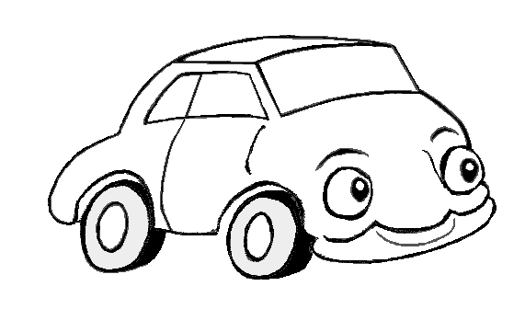
Different ways to change V
v
v
Car speeds up
a
v
v
Car slows up
screech!
a

Slide 24
Accelerations
v
v
Car turns
a
In all three cases, v changes.
Therefore these are all examples of accelerations

